Slide 1
Proposed Methodology
Spatio-Temporal-Causal-Reasoning-with-Uncertainty-Awareness-for-Temporal-Knowledge-Graph-Completion
(STCR – TKGC)
Graph Mining – C2
Alankrit Sinha
Ankit Kumar Singh

Slide 2
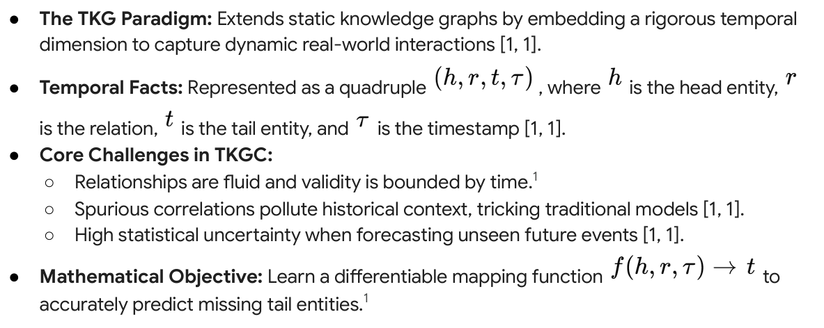
Introduction To TKG:

Slide 3
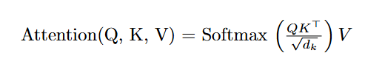

Feedback From C1 – Bottleneck of Transformers vs SSM
Complexity: Since Q and K are matrices of size L times d, the product QK^T results in an L X L matrix.
The "Memory Wall": For a sequence of 365 days, the model must store and compute 365^2 = 133,225 attention
scores per head at every layer.
Paper : https://arxiv.org/abs/1706.03762
Complexity: O(L . d). The computation grows linearly with the number of days.
The Efficiency: The model only needs to store the current state h_t (the "latent political climate"),
regardless of whether it is on Day 10 or Day 310.

Slide 4
Dataset – ICEWS14
Definition: A Temporal Knowledge Graph (TKG) dataset containing political events from the year 2014.
Format: Facts are represented as quadruples: (Subject, Relation, Object, Timestamp).
Example: (Barack Obama, Make a visit to, China, 2014-11-10).
Data Granularity: The dataset has a daily resolution (24-hour intervals), covering 365 discrete time steps.

Slide 5
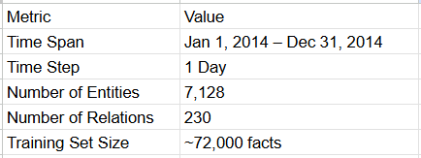
Entities: ~7,128 (Countries, Leaders, Organizations, etc.).
Relations: ~230 (Consult, Accuse, Appeal, Fight).
Total Facts: ~90,000+ unique events.

Slide 6
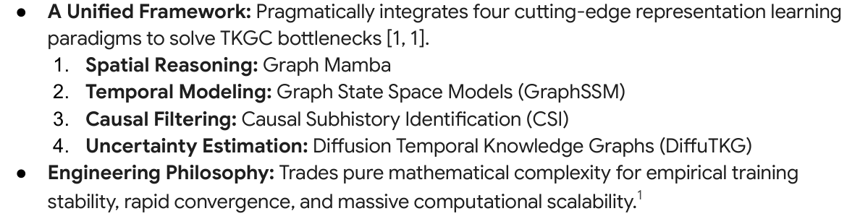
PROPOSED ARCHITECTURE

Slide 7
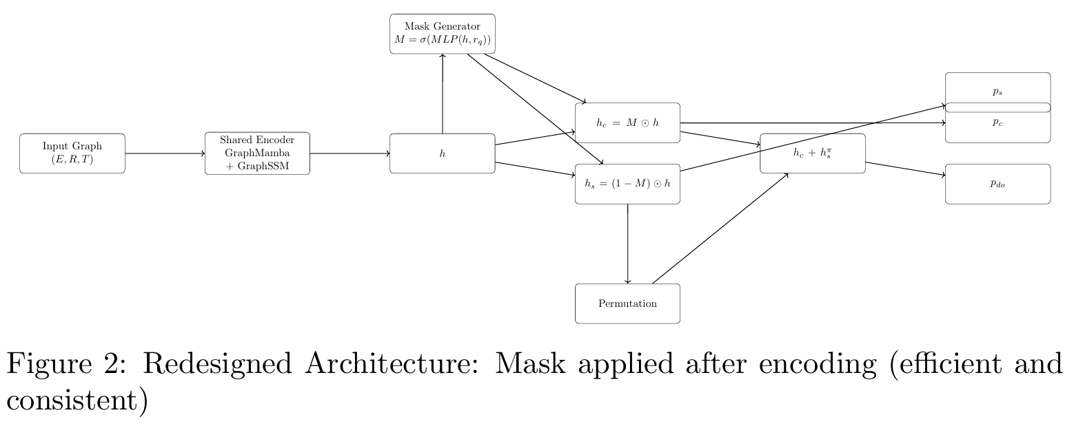
FINAL ARCHITECTURE

Slide 8
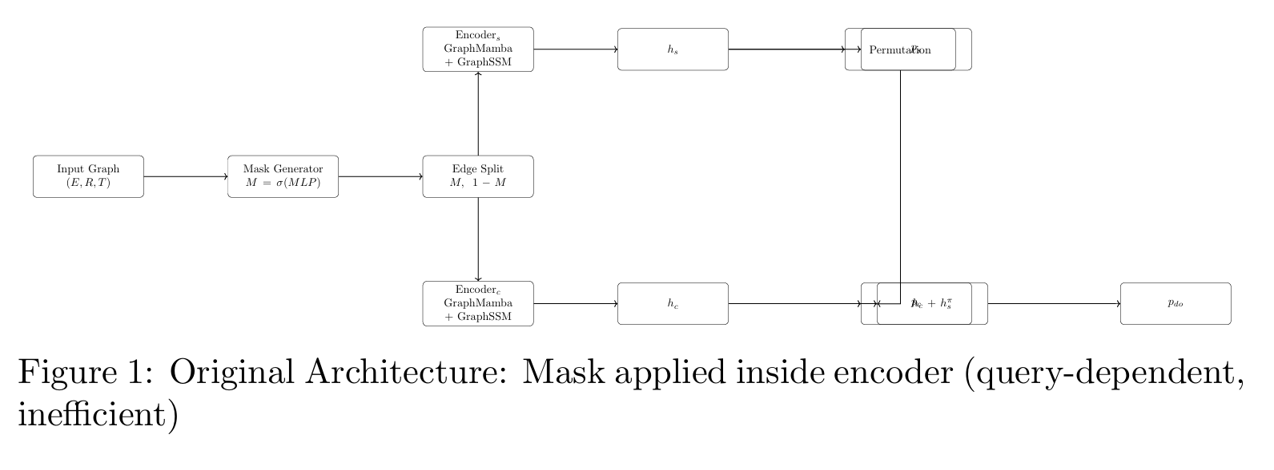
INITIAL ARCHITECTURE

Slide 9
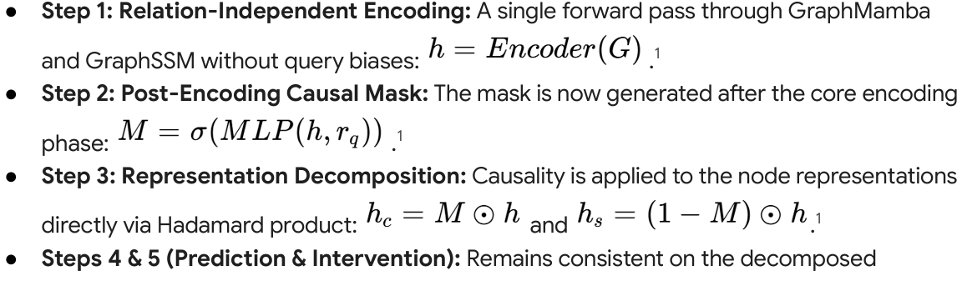
REDESIGNED ARCHITECTURE

Slide 10
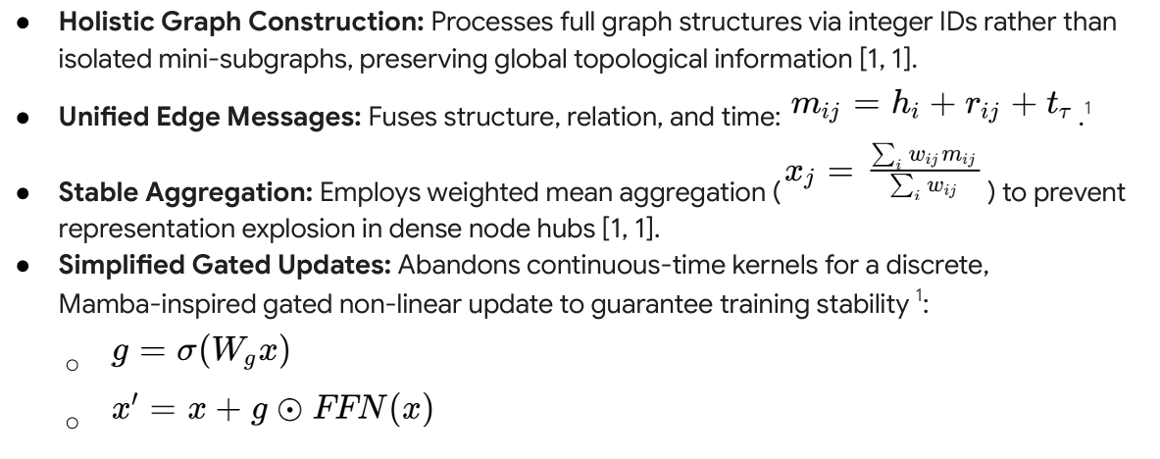
Spatial Reasoning

Slide 11
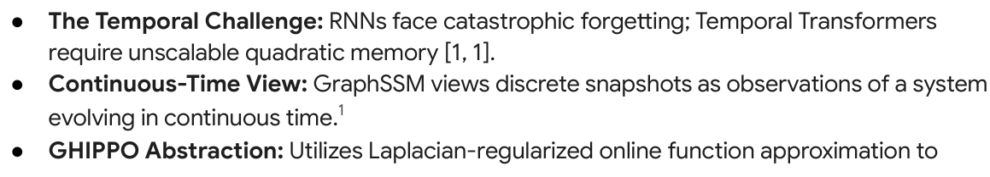
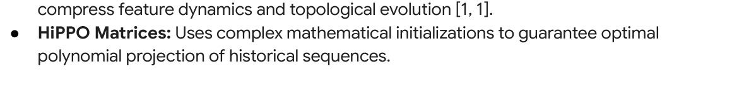
Temporal Reasoning

Slide 12
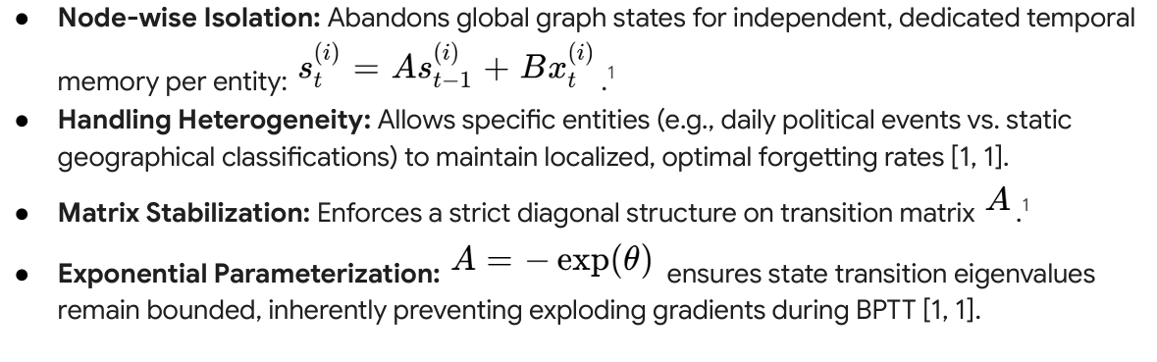
Temporal Reasoning

Slide 13
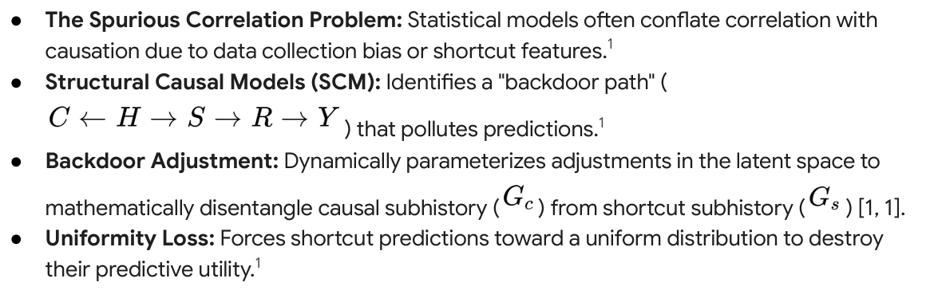
Causal Reasoning

Slide 14
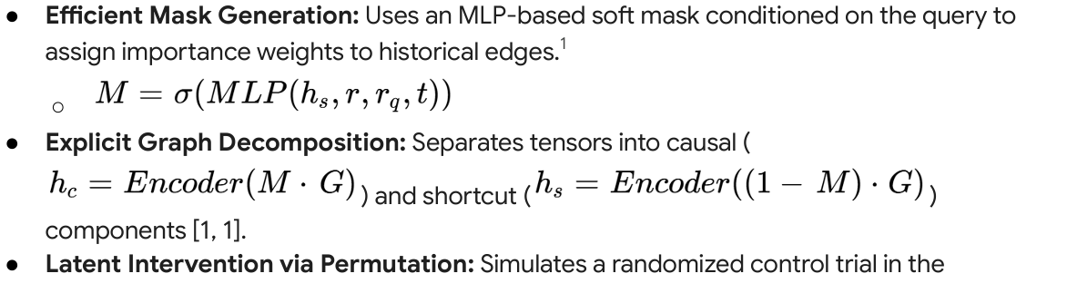
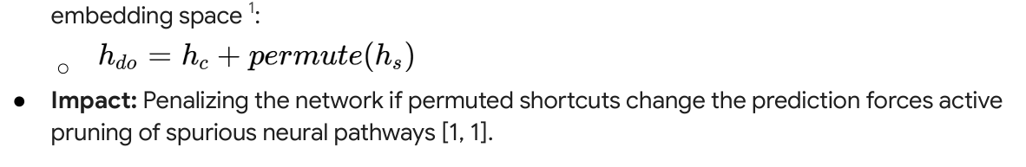
Causal Reasoning

Slide 15
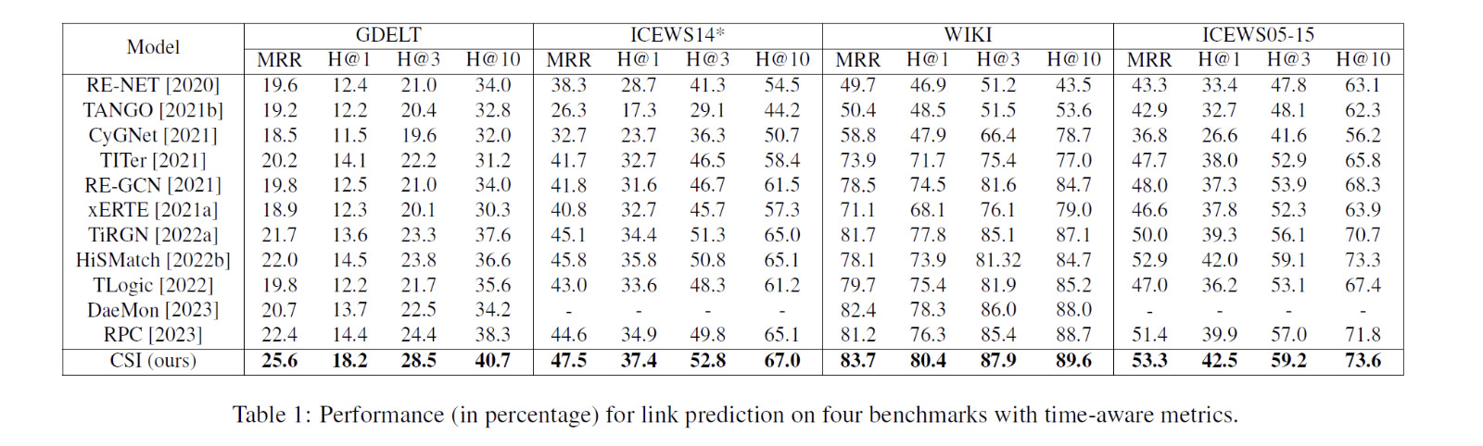
OUR MODEL | MRR 18.3 | H@1 9.83 | H@3 18.8 | H@10 26.21

Slide 16
C3 - Plans
- Full Application of Mamba Block
-Full DiffuTKG integration as the final prediction layer.
-Graduate from a deterministic oracle to a fuly uncertainty-aware probabilistic forecasting engine.
-LLM for semantic initialization to solve cold start problem.

Slide 17
Thank
You

